Slide 1

Oil and Gas consumption and prices
Long-term forecasting
Ironhack-Berlin
31.07.2020

Slide 2
Fossil fuel products and uses
Crude Oil, Natural Gas, Coal
Energy
Non-Energy
Transportation
Electricity and Heating
Manufacturing and Petrochemicals
Fertilizers

Slide 3
1.
Factors impacting Oil & Gas prices
……………and how?

Slide 4







Demand
Global market changes
Supply
Governmental regulations
Gas storage
Financial forecasts
Weather forecast

Slide 5
Demand
Global market changes
Supply
Governmental regulations
Gas storage
Financial forecasts
Weather forecast

Slide 6
2.
Who has the power?
……………and how much?

Slide 7
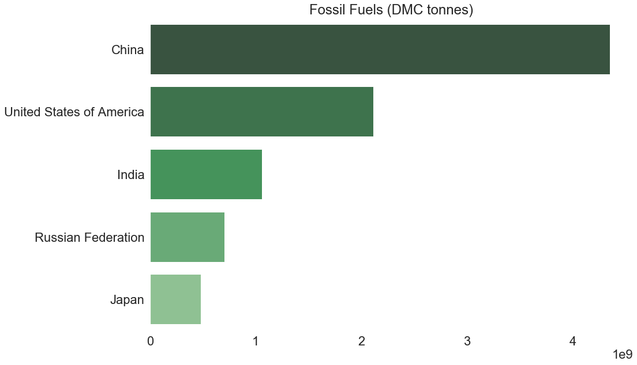
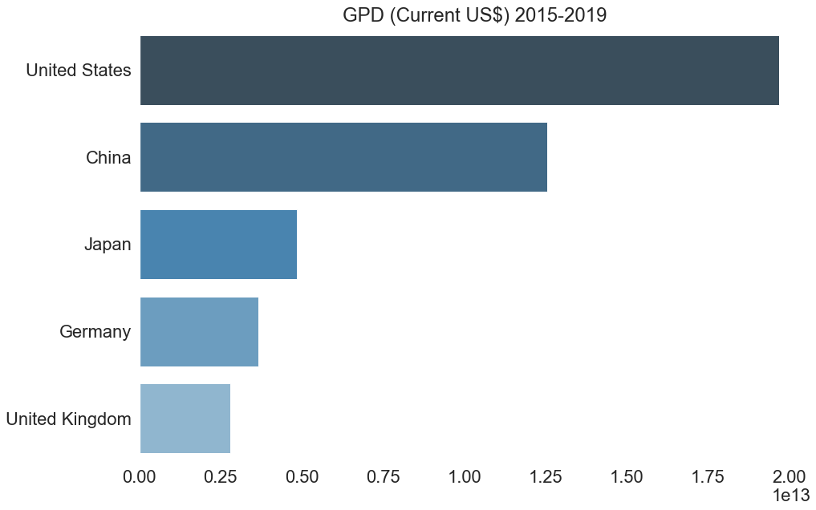
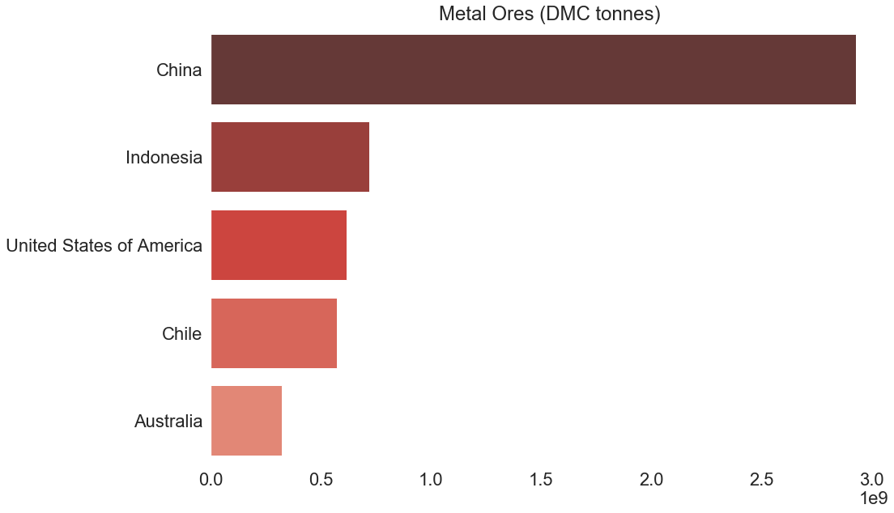
Data: UN Environment Programme GMFD
Data: The WorldBank IBRD IDA
Data: UN Environment Programme GMFD

Slide 8
3.
Is the impact of consumption measurable?
……………and statistically significant?

Slide 9
Multi-linear regression (MLR) Model
MODEL
Input
Output
Consumption 1970-2017
yi​=β0​+β1​xi1​+β2​xi2​+...+βp​xip​+ϵ
Fossil Fuel prices forecast
China, India, USA
where, for i=n observations:
yi​=dependent variable
xi​=expanatory variables
β0​=yintercept (constant term)
βp​=slope coefficients for each explanatory variable
ϵ=the model’s error term (also known as the residuals)​

Slide 10
R²=0.789
p-value <0.05
~ 80 %
That explains a lot!
And it is statistically significant
Success!

Slide 11
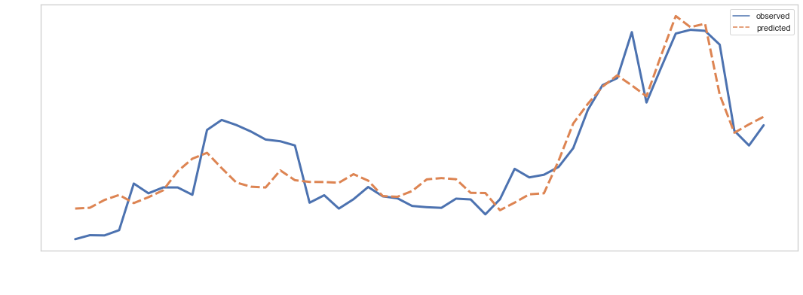
Running the MLR model
Arab Oil embargo
Iranian Revolution
Country regulations
US Oil Industry
Over-supply
Emerging markets
Global recession
Data: The WorldBank IBRD IDA | UN Environment Programme GMFD

Slide 12
Why is this important?
Oil & Gas Companies
Exploration and Production campaigns
R&D
Renewable Energy
Estimating the Economic feasability of Renewable energy and their technologies

Slide 13
Key takeaways:
Demand
Plays a KEY role in the Fossil Fuel prices.
China, US, and India
Are responsible for ~80% of the Oil & Gas prices.
Forecasting:
Estimating production can be the key to predicting long term Oil & Gas prices.

Slide 14
Thanks!
For detailed EDA and the models please refer to:
https://github.com/IbtisamBeik/Data-analysis.git

Slide 15
Resources
UN Environment Programme International Resource Panel Global Material Flows Database (https://www.resourcepanel.org/global-material-flows-database)
The WorldBank IBRD IDA: https://databank.worldbank.org/source/world-development-indicators
The WorldBank IBRD IDA (The Pink Sheet): https://www.worldbank.org/en/research/commodity-markets
https://www.appenergy.com/2017/01/23/10-factors-that-affect-the-cost-of-energy

Slide 16
4.
Is the past a key to the future ?
……………Inversed uniformitarianism!

Slide 17
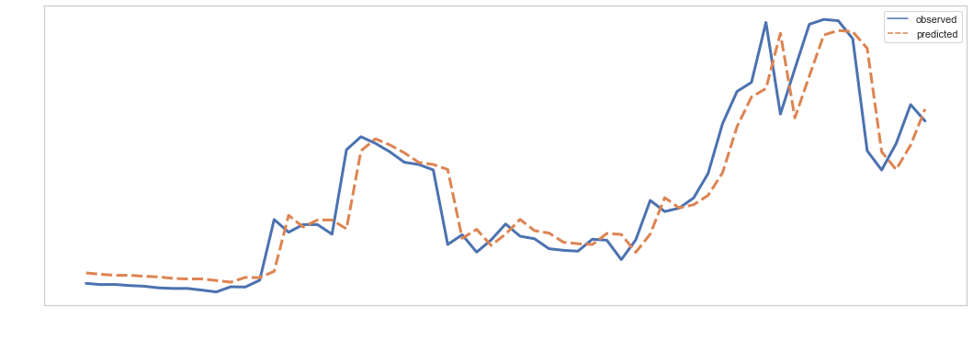
Running an Autoregressive model on time series

